Slide 1
Franklin Templeton Fixed Income (FTFI)
Central Banking Spring Meetings
February 2025
Presented by:
Joshua Lohmeier, CFA
Senior Vice President, Portfolio Manager
Investment Grade
Franklin Templeton Fixed Income

Slide 2
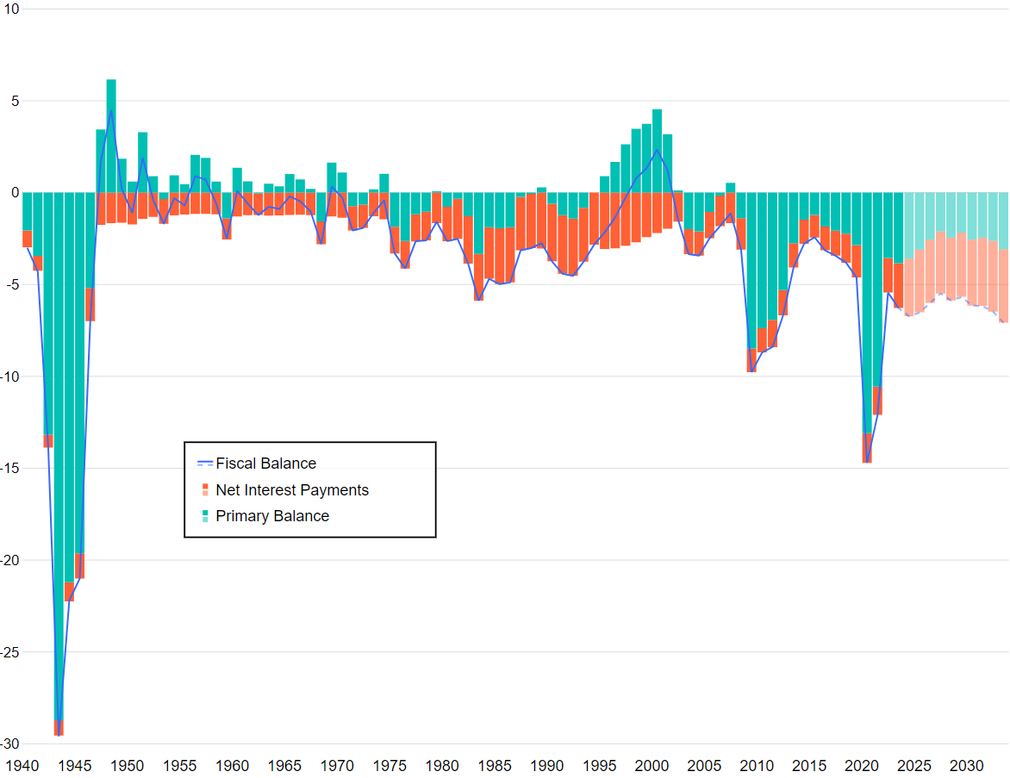
FTFI Market Outlook Fiscal Policy to Remain Loose With Elevated Deficits
1940–2030 (Forecast)
Percent GDP
Sources: CBO, Macrobond. Analysis by Franklin Templeton Fixed Income Research. As of January 15, 2025. There is no assurance that any estimate, forecast or projection will be realized.
2

Slide 3
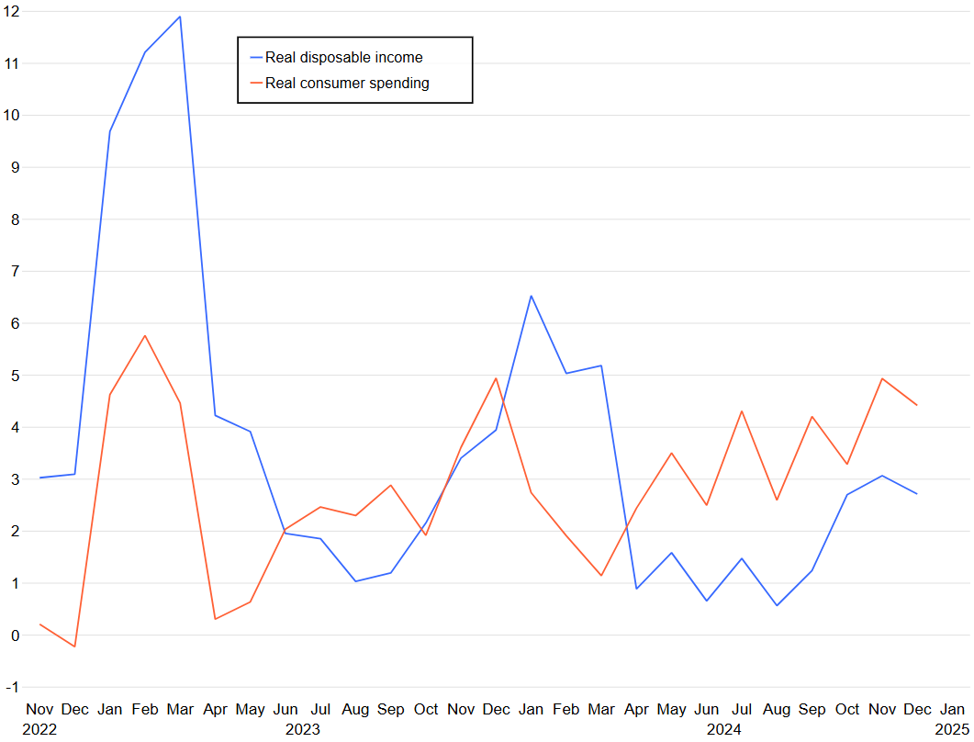
FTFI Market Outlook Consumer Spending Remains Solid; Real Income Growth has Trended Higher
2022–2025
Percent, 3-Month Annualized Rate
Sources: BEA, Macrobond. Analysis by Franklin Templeton Fixed Income Research. As of January 31, 2025.
3

Slide 4
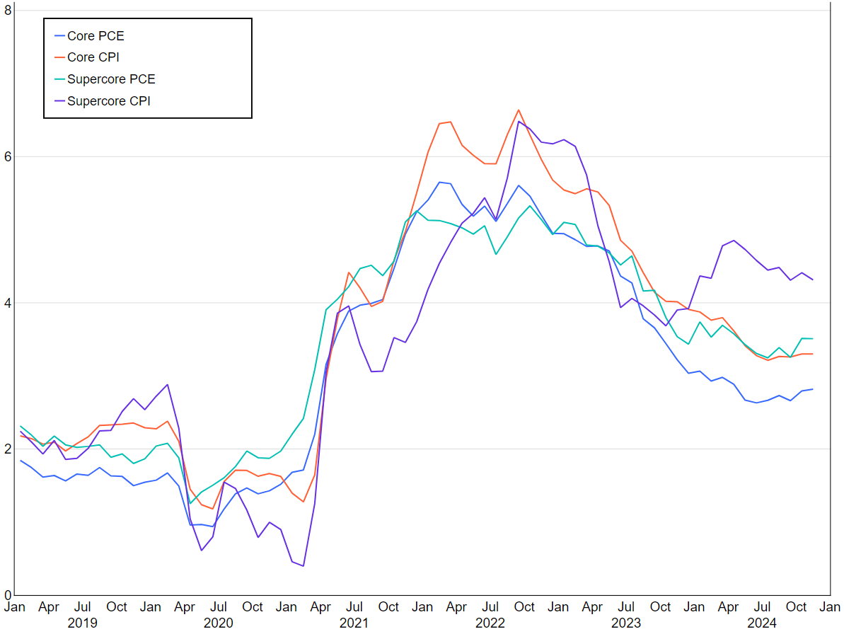
FTFI Market Outlook Disinflation Has Stalled in Recent Months
2019–2024
Percent, Year/Year
Sources: BEA, BLS, Macrobond. Analysis by Franklin Fixed Income Research. As of January 13, 2025.
4

Slide 5
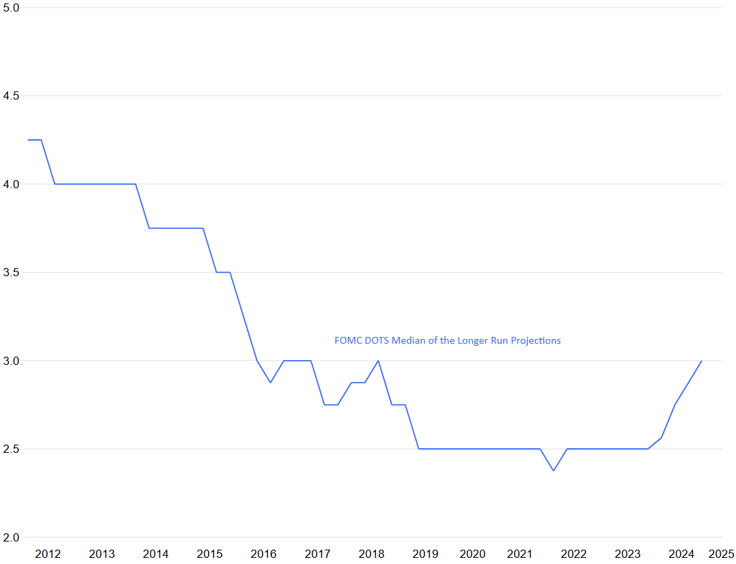
FTFI Market Outlook Longer-Run Rate Projection Has Risen Over the Past Year
2012–2025
Percent
FOMC DOTS Median of the Longer-Run Projections
Sources: Bloomberg, Macrobond. Analysis by Franklin Templeton Fixed Income Research. As of January 30, 2025. FOMC DOTS provide a snapshot of where the committee members project the fed funds rates will be in the future. There is no assurance any estimate, forecast or projection will be realized.
5

Slide 6
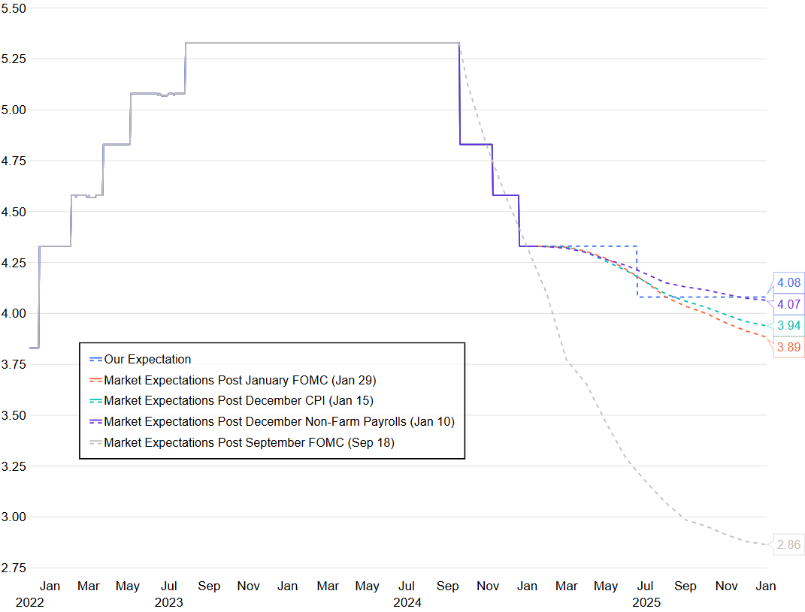
FTFI Market Outlook Markets Pricing in a 25-bp Cut by Mid-2025 and Possibly One More by Year-End
2022–2025
Percent
4.08
4.07
3.94
3.89
2.86
Sources: New York Fed, CME Group, Macrobond. Analysis by Franklin Fixed Income Research. As of January 30, 2025. There is no assurance any estimate, forecast or projection will be realized.
6

Slide 7
FTFI Market Outlook All-In Yields are Still Attractive
December 2014–December 2024
Yield to Worst (%)
Source: Bloomberg. Analysis by Franklin Templeton Fixed Income Research. As of December 31, 2024. Source: Past performance is not a guarantee of future results. Bar chart represents historical range. Indices: Bloomberg US Generic Government 10 Year, Bloomberg US Agg Total Return Value Unhedged USD, Pan-European Government Index, Bloomberg US Corporate Total Return Value Unhedged USD, Bloomberg US MBS Index Total Return Value Unhedged USD, ICE BofA US High Yield Index, Bloomberg Municipal Bond Index, JP Morgan EMBI Global Diversified Composite, and Credit Suisse Leveraged Loan Total Return.
7

Slide 8
 | Portfolio construction & efficient risk allocation

Slide 9
Accessing higher quality, shorter duration credit
Performance and Risk
10 Year
 | Intermediate US Government | Intermediate US Govt / Credit | Intermediate Credit | 75% 1-5yr BBB & 25% 5-10yr A-or Better
Current Yield | 4.36% | 4.60% | 5.05% | 4.97%
10 Yr Avg Yield | 2.18% | 2.55% | 3.15% | 2.60%
Annualized Returns | 1.24% | 1.71% | 2.42% | 2.44%
Standard Deviation | 3.18% | 3.32% | 4.23% | 3.68%
Sharpe Ratio | 0.39 | 0.51 | 0.57 | 0.66
Source: Bloomberg. Data as of December 31, 2024.
For institutional and professional use only. Not for distribution to retail investors.
9

Slide 10
Comparing spread volatility in Investment Grade Credit
Cross-Sector Yield Spread Comparisons
Optimal Carry Points on the Spread Curve
Optimal
Carry
Source: Bloomberg. Data as of September 30, 2024.
For illustrative purposes only. The information provided is not a recommendation to purchase, sell or hold any particular security.
Chart Left Side: Securities selected for illustrative purpose to highlight differences in volatility although they are in the same sectors (Consumer Cyc. and Technology shown for example here). Sizable issuers within each of the four custom sectors were selected to illustrate the historical spread volatility of the broader custom sectors they represent.
Chart Right Side: These sectors shown are custom built pursuant to the team's framework. Sizable issuers within the mid beta banks, low beta technology, and high beta pipelines were selected to show representative spread curves of the broader custom sectors they represent. “Optimal carry” defined as the most efficient place to earn yield given the structural composition of the spread curves shown in terms of adding incremental return from roll-down and through building a balanced, beta and duration neutral portfolio.
For institutional and professional use only. Not for distribution to retail investors.
10

Slide 11
Important Information
The value of investments can go down as well as up, and investors may not get back the full amount invested. Fixed income securities involve interest rate, credit, inflation and reinvestment risks, and possible loss of principal. Active management does not ensure gains or protect against market declines. An investment in a money market is not a bank account and is not insured or guaranteed by the Federal Deposit Insurance Corporation or any other government agency. Bond prices generally move in the opposite direction of interest rates. Thus, as prices of bonds in an investment portfolio adjust to a rise in interest rates, the portfolio’s value may decline. Changes in the credit rating of a bond, or in the credit rating or financial strength of a bond’s issuer, insurer or guarantor, may affect the bond’s value.
This material is intended to be of general interest only and should not be construed as individual investment advice or a recommendation or solicitation to buy, sell or hold any security or to adopt any investment strategy. It does not constitute legal or tax advice. This material may not be reproduced, distributed or published without prior written permission from Franklin Templeton.
The views expressed are those of the investment manager and the comments, opinions and analyses are rendered as at publication date and may change without notice. The underlying assumptions and these views are subject to change based on market and other conditions and may differ from other portfolio managers or of the firm as a whole. The information provided in this material is not intended as a complete analysis of every material fact regarding any country, region or market. There is no assurance that any prediction, projection or forecast on the economy, stock market, bond market or the economic trends of the markets will be realized. The value of investments and the income from them can go down as well as up and you may not get back the full amount that you invested. Past performance is not necessarily indicative nor a guarantee of future performance. All investments involve risks, including possible loss of principal. Before investing, carefully consider a fund's investment objectives, risks, charges and expenses. You can find this and other information in each prospectus, summary prospectus, if available, at www.franklintempleton.com Please read it carefully.
Any research and analysis contained in this material has been procured by Franklin Templeton for its own purposes and may be acted upon in that connection and, as such, is provided to you incidentally. Data from third party sources may have been used in the preparation of this material and Franklin Templeton ("FT") has not independently verified, validated or audited such data. Although information has been obtained from sources that Franklin Templeton believes to be reliable, no guarantee can be given as to its accuracy and such information may be incomplete or condensed and may be subject to change at any time without notice. The mention of any individual securities should neither constitute nor be construed as a recommendation to purchase, hold or sell any securities, and the information provided regarding such individual securities (if any) is not a sufficient basis upon which to make an investment decision. FT accepts no liability whatsoever for any loss arising from use of this information and reliance upon the comments, opinions and analyses in the material is at the sole discretion of the user.
Products, services and information may not be available in all jurisdictions and are offered outside the U.S. by other FT affiliates and/or their distributors as local laws and regulation permits. Please consult your own financial professional or Franklin Templeton contact for further information on availability of products and services in your jurisdiction.
All investments are subject to certain risks, including possible loss of principal. Generally, investments offering the potential for higher returns are accompanied by a higher degree of risk. Below investment grade bonds will have more credit risk, may be less liquid and may have a greater risk of default than higher-quality, investment grade bonds. Securities markets can fluctuate significantly in response to industry, financial or economic developments, and unexpected events, such as the spread of deadly diseases or disasters, can cause investor fear and panic, which can adversely affect companies, sectors and the market in general. Investors should review their investment objectives, risk tolerance and liquidity needs before choosing a manager. There is no guarantee that investment strategies will work under all market conditions and investors should evaluate their ability to invest for the long term, especially during periods of market downturns.
This piece is intended for institutional investment management consultants or investors interested in institutional products and services available through Franklin Templeton Institutional and its affiliates. Various account minimums or other eligibility qualifications apply depending on the investment strategy or vehicle.
South Africa: Issued by Franklin Templeton Investments SA (PTY) Ltd which is an authorised Financial Services Provider. Tel +27 (21) 831 7400, Fax +27 (21) 831 7422
Please visit www.franklinresources.com to be directed to your local Franklin Templeton website.
Copyright © 2025 Franklin Templeton. All rights reserved.
For institutional and professional use only. Not for distribution to retail investors.

