Slide 1

DHOWCSD PRESENTATION
CENTRALBANKING SPRING MEETING
February 25, 2025
Central Bank of Kenya

Slide 2
Outline
Background
Project Objectives
Project Governance Structure
Overview/Scope of DhowCSD Project
Project Implementation
Challenges
Benefits

Slide 3
1.
Background
Prior to implementation of the DhowCSD
  Inefficient IT infrastructure for Government Securities Operations
  Limited Capacity to support Market Development e.g New Products
  Poor Liquidity Distribution
  Inefficient operational processes with significant manual interventions
  Paper based transactions for Government Securities
  Operational Risks
  Settlement in Commercial Bank Money

Slide 4
2.
Project Objectives
DhowCSD Project Objectives
  Enhance Monetary Policy Operations
  Financial Market Deepening
  Increase liquidity and liquidity Distribution in the Primary and Secondary Market
  Promote Capital Market Growth
  Automation and increased Operational efficiency
  Enhanced Risk Management
  Compliance with international standards (CPMI, IOSCO, ISO, etc.), Secure, Scalable, Resilience.
  Improved Customer/Investor Experience

Slide 5
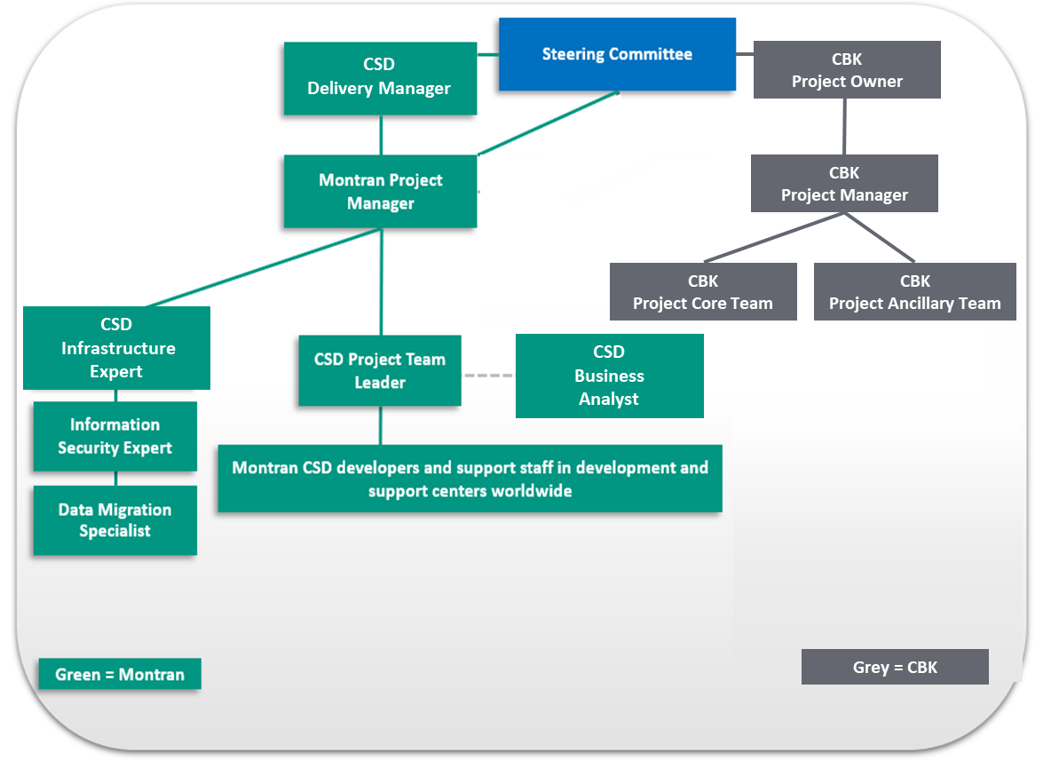
3.
Project Governance Structure

Slide 6
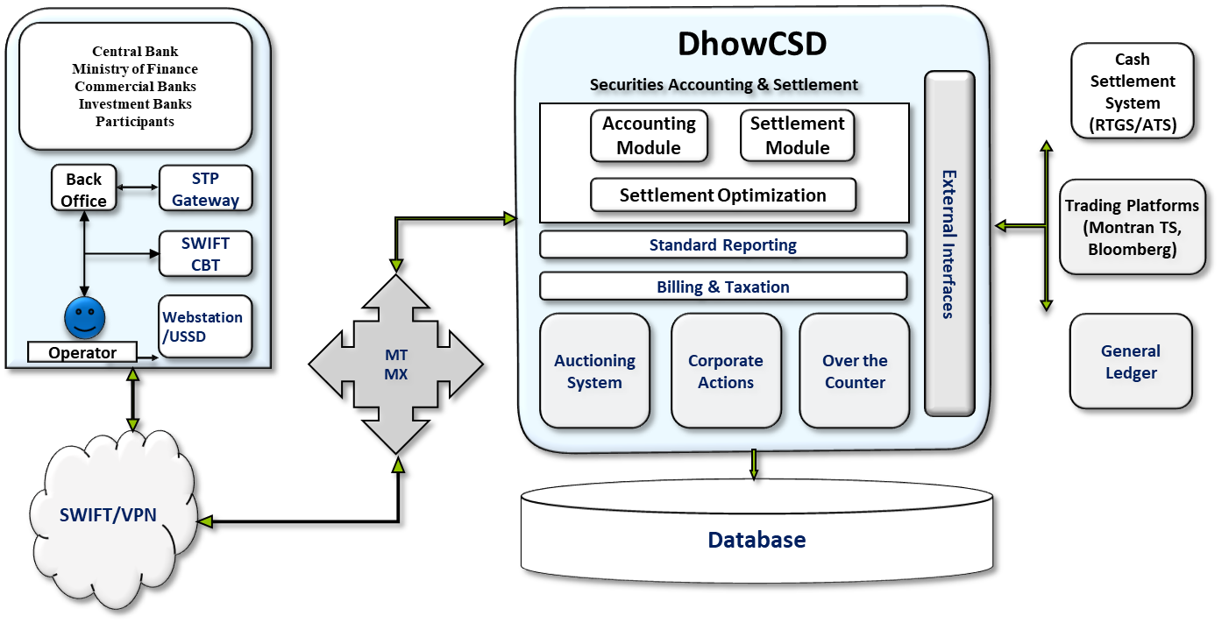
4.
Overview/Scope of DhowCSD

Slide 7
6.
Project Implementation
Approach
  Project Management based on PRINCE2 (Projects In Controlled Environments) international standard.
  Development Activates based on Waterfall standard
  Phased Approach
Governance Framework
Project Charter:
Defined roles and responsibilities of each party and the project plan.
    Outlined methodologies used in order to achieve project objectives finalized. Including Project Management Procedures, Training and Documentation Plans, UAT cycles , List of Deliverables and key Milestones.
    Change Management framework.
    Project Risk Assessment and Management framework

Slide 8
7.
Challenges
Challenge | Impact | Mitigations
Covid -19 Pandemic | On-site support Team Absence Team Collaboration. | Virtual workshops &meeting . Use of virtual collaborative tools
Project Team size not optimal for Scope of Project & | Difficulty meeting project Timelines | Team members took up multiple functions/roles. On-site accommodation
Initial Project Design did not meet CBK expectations | Solution re-design | Extension of Project timelines
Decision making | No prior Experience with a CSD | Research and consultation with the vendor and NBG.
Departure key Team members | Setback on Delivery | Intensive Training of new staff. Teams trained on multiple functions

Slide 9
9.
BENEFITS OF DhowCSD
  Enhanced effectiveness in Monetary Policy Monetary Policy Transmission
  Enhanced effectiveness and efficiency in Domestic Debt Management.
  Financial Market Deepening
  Enhanced Transparency
  Increase liquidity and liquidity Distribution in the Primary and Secondary Market
  Exponential increase in number of new investors. Over 60,000 new accounts opened since the roll out of the DhowCSD on July 31, 2023 compared to the 44,000 opened in over twenty-six years prior.
  Introduction of New Products
  Increased operational efficiency and Reduction of Risks
  Compliance with international standards (CPMI, IOSCO, ISO, etc.), Secure, Scalable, Resilience.
  Improved Customer/Investor Experience

Slide 10


