Slide 1
Macroeconomic resilience: Navigating inflation and debt management amid global uncertainty
Central Banking Spring Meeting
Gerardo García
February, 2025

Slide 2
The views and opinions expressed in this presentation are my own and do not necessarily reflect the official position of Banco de México.
  This document has been prepared exclusively for its use during the Central Banking Spring Meetings hosted by Central Banking on February 25th,2025.
  Partial or total reproduction, modification, use, disclosure, and/or inappropriate or unauthorized distribution of any information without the prior consent of Banco de México may be prosecuted under Mexican law. Banco de México reserves the right to pursue in any form of legal action, including any damages, that could result from the inappropriate or unauthorized use of the information contained herein.

Slide 3
Economic Growth Outlook Advanced Economies
U.S. economic activity has been solid and stronger than expected, in contrast to other economies where economic growth has been weak and fallen below expectations.
Evolution of the 2025 Real GDP Growth Forecast for Selected Countries
Percentage
Source: Bloomberg.

Slide 4
Trade Uncertainty and inflation
In the context of the recent political developments in the U.S., trade uncertainty has increased, affecting financial markets and keeping volatility elevated.
Strong growth and potential trade disruptions have pushed inflation expectations higher in the United States, suggesting that inflation might be more persistent.
United States: Evolution of 1 Year Inflation Swaps and Density Derived from the Cap and Floor Market
Percent
United States: Trade Policy Uncertainty Index
Index: Long-Term Average = 100
Source: "Measuring Economic Policy Uncertainty" by Baker, Bloom, and Davis (2016). Note: The index reflects the frequency of articles in U.S. newspapers that analyze economic uncertainty related to policies and also contain one or more references to trade policy.
Source: Banco de México with data from Bloomberg. The probability density function is derived through the SABR methodology using zero coupon caps and floors. Using information on the US CPI.

Slide 5
Monetary Policy Expectations and the U.S. dollar strength
Therefore, markets anticipate that interest rates will remain higher for longer, which has also reinforced expectations that the U.S. dollar will remain strong.
Evolution of Selected SOFR Futures Contracts
Percentage
DXY^{1/} Index and Implied Density in 1-Year Options
Units
Source: Bloomberg. 1/DXY: A weighted average calculated by the Intercontinental Exchange (ICE) of the nominal exchange rate of the six major globally traded currencies with the following weights: EUR: 57.6%, JPY: 13.6%, GBP: 11.9%, CAD: 9.1%, SEK: 4.2%, and CHF: 3.6%.
Source: Bloomberg. Note: Expected cuts are considered to be 25 bp, while the thresholds for defining these cuts are calculated in relation to the effective federal funds rate.

Slide 6
Debt Sustainability and long term rates
These factors, along with concerns about loose fiscal policies—particularly in the United States—have driven up long-term rates, supported by the term premium and, to a lesser extent, higher expectations of short-term rates.
Evolution of General Government Gross Debt of Selected Advanced Economies
Percent of GDP
United States: Evolution of the Expected Short-Term Rate, Term Premium and 10Y Yield
Percentage; percentage
Source: International Monetary Fund. Gross debt consists of all liabilities that require payment or payment of interest and/or principal.
Source: Bloomberg. Estimations from the ACM model.

Slide 7

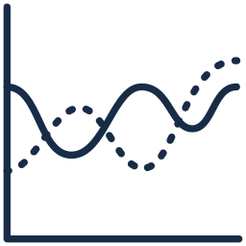
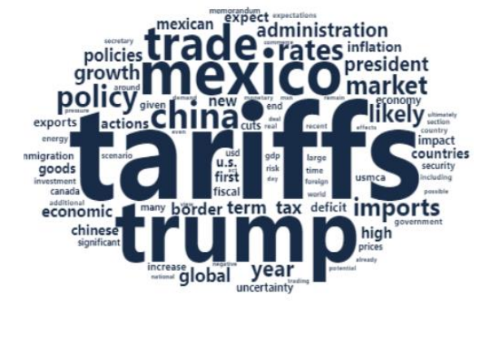




Implications for 2025
  The current uncertain environment poses significant challenges to the conduct of economic policy in emerging market economies. It could also have a significant impact on central banks´ reserve management strategies.
Word cloud of prevalent risks to the Mexican economy associated with the new administration in the United States
Portfolio’s Strategy in 2025
  Limited duration risk
  Increase allocation to inflation- linked bonds
  Increase exposure to money market instruments
  Reduce allocation to the long-end of sovereign curves
  Reduce exposure to credit spread instruments
      Decrease exposure to currencies other than the USD while maintaining it in those that offer diversification benefits
  Increase exposure to gold
Source: Banco de México with data from Banorte, Barclays, Credit Agricole, Societe Generale, Citi, Banamex, Nomura, Natixis, and Goldman Sachs.
Source: Banco de México.

