Slide 1
The Foreign Exchange Global Code
February 2025

Slide 2
Agenda
  Background on the Global Foreign Exchange Committee (GFXC) and the FX Global Code
  Benefits of adopting the Code
  FX Global Code adoption
  Three-year review of the FX Global Code
  GFXC Working Groups 2025 Agenda

Slide 3
The GFXC
  The GFXC was established in May 2017 as a forum, bringing together central banks and private sector participants.
  The objectives of the GFXC are:
  to promote collaboration and communication among the local FX committees (LFXCs) and non-GFXC jurisdictions with significant FX markets,
  to exchange views on trends and developments in global FX markets, including on the structure and functioning of those markets, drawing on information gathered at the various LFXCs,
  to promote, maintain and regular basis the FX Global Code and to consider good practices regarding effective mechanisms update on a to support adherence.

Slide 4
GFXC Membership
  Members of the GFXC include central bank-sponsored LFXCs and similar structures.
  Members currently include:
Full Members
Australia | Euro Area | Mexico | South Korea
Brazil | Hong Kong | Nordic Countries | Switzerland
Canada | India | Singapore | United Kingdom
China | Japan | South Africa | United States
Associate Members
Georgia
Indonesia
Israel

Slide 5
GFXC Membership
  LFXCs may apply to join the GFXC as Full Members if they meet the following criteria:
  Be either (a) an established, central bank sponsored, LFXC or (b) a committee with a similar structure, which includes membership from both the relevant central bank and the private sector.
  Undertake to endorse and actively promote the Code.
  Have a minimum of 1% global FX turnover by currency, or sum of currencies, according to the latest BIS Triennial Survey of FX.
  LFXCs which meet some but not all of the Full Member criteria may be considered for participation in the GFXC as Associate Members.

Slide 6
History of the FX Global Code
Background
A code of conduct
FX Global Code
2021
2024
g
The FX market is largely unregulated
Major shifts in market structure, transparency and regulatory focus in the aftermath of the Great Financial Crisis
FX market misconduct investigations in 2013/14
The Foreign Exchange Working Group (FXWG) worked towards developing an FX Code of Conduct, under the auspices of the BIS Markets Committee
The FX Global Code was published in 2017
The GFXC was launched in 2017 to bring together central banks and industry representatives to promote good practices in the FX market and maintain the Code
The first three-year review of the FX Global Code was completed
Reports on Last Look and Pre-Hedging have been published
The second three-year review was completed
FX Settlement Risk and the use of FX Data were the key focus areas

Slide 7






The FX Global Code Principles
 | Ethics | Market Participants are expected to adhere to high ethical and professional standards to promote the fairness and integrity of the FX Market.
 | Governance | Market Participants are expected to have sound and effective governance framework in place. This framework should provide clear responsibility and comprehensive oversight of their FX Market activity and promote responsible engagement in the FX Market.
 | Execution | Market Participants are expected to exercise due care when negotiating and executing transactions in order to promote a robust, fair, open, liquid, and appropriately transparent FX Market.
 | Information Sharing | Market Participants are expected to ensure be clarity and accuracy in their communications and to protect Confidential Information to promote effective communication that fosters a robust, fair, open, liquid, and appropriately transparent FX Market.
 | Risk Management & Compliance | Market Participants are expected to promote and maintain a robust control and compliance environment to effectively identify, manage, and report on the risks associated with their engagement in the FX Market.
 | Confirmation & Settlement | Market Participants are expected to implement robust, efficient, transparent, and risk-mitigating post-trade processes to ensure the predictable, smooth, and timely settlement of transactions in the FX Market.

Slide 8






Benefits of FX Global Code adoption
Offers valuable understanding on key topics in the FX Market | Signalling effect - sends a message that your institution is committed to conducting FX Market activities in a manner consistent with the Code | Provides greater confidence that the FX Market is functioning appropriately and in a fair and efficient way
Fosters a level playing field between buy-side and sell-side | Allows firms to continuously improve and benchmark their internal policies and procedures | Contribute to ongoing discussions at LFXCs on improving the FX Market

Slide 9
Adoption of the FX Global Code continues to increase
  During 2024, 37 Statements of Commitment were included in the GFXC Global Index of Public Registers, reaching a total of 1,328 entries.

Slide 10
Adoption of the FX Global Code by institution
  Banks hold the largest share of representation in the Global Index of Public Registers, followed by buy-side participants and brokers or investment advisers.

Slide 11
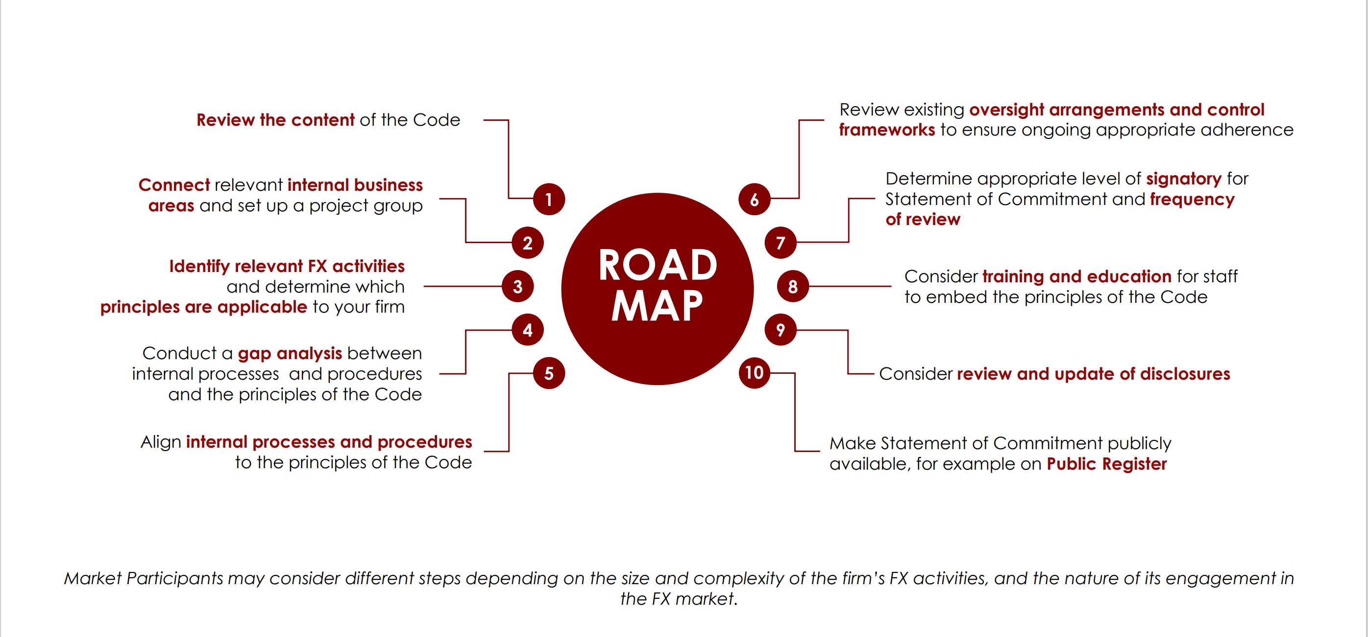
Roadmap to adopting the FX Global Code

Slide 12
Three-year review of the FX Global Code (2024)
  The GFXC identified several key areas for review to ensure that the Code continues to provide appropriate guidance and contributes to an effectively functioning FX market and remains in step with its evolution.
  The 2024 Code amendments focus on five of the Code’s fifty-five principles (P9, P10, P35, P50, and P51), and the Disclosure Cover Sheets for Liquidity Providers and Platforms. The modifications were designed to improve guidance on FX Settlement Risk mitigation practices, and to enhance transparency around certain types of execution activity and on the utilisation of FX data.
  The amendments also include the addition of new illustrative examples, glossary entries and a modification to the Foreword section of the Code to include the links to existing GFXC reports, which were developed to provide further clarity on certain topics.

Slide 13



GFXC Working Groups 2025 Agenda
Motivation for Adherence Working Group
FX Settlement Risk Working Group
FX Data Working Group
Promote greater knowledge sharing and increased visibility on the FX Global Code. The areas of focus are:
Form partnerships with industry groups and rating agencies
Enhance Code education and training
Promote the Proportionality Self-Assessment Tool and consider whether modifications are needed to the Disclosure Cover for some buy-side participants
Reduce FX settlement risk by encouraging the use of payment-versus-payment mechanisms. The areas of focus are:
  Analyse the results of the LFXCs’ FX Settlement Survey
  Analyse the results of the BIS Triennial Survey to assess the amount of FX Settlement Risk in the market and consider ways to mitigate it
  Analyse the impact of accelerated securities settlement on the FX Market
Analyse how the use of FX data can be made more transparent and evenly accessible to all market participants to improve market transparency and level the playing field. The areas of focus are:
Discuss the availability and use of reference data for derivatives transactions, with a focus on swaps
Analyse the adoption of the updated Disclosure Cover Sheets for Liquidity Providers and Platforms

Slide 14
Contact Information
  For additional details on the GFXC and the FX Global Code, please visit the GFXC website
  For general information about the Global Foreign Exchange committee: email@globalfxc.org
  For media enquiries: media@globalfxc.org

Slide 15


