Slide 1
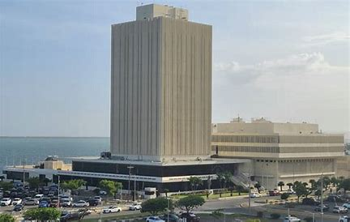
Securities Supervision and its Risk Universe
"One Size Fits All and Easy to Mitigate:
Absolutely NOT !"
Errol Cova, Director Supervision
30 September 2025

Slide 2

Global Securities Markets:
Some quick observations
Transition from a predominantly banking centric financial system to a market-based system happening (!?).
The Securities/Capital Market of emerging markets can be deemed shallow and underdeveloped as a result of a lack of secondary market conditions and local retail investors’ participation.
The Securities/Capital Markets in emerging markets such as Jamaica have potential for growth and potential to create a vibrant financial market with a global interconnectedness.
Proper surveillance of the eco-system is of utmost importance.

Slide 3
Key Elements of a sound Financial System
The effective flow of funds between savers, borrowers, and investors requires the existence of a modern and efficient financial system* comprising of specialist financial institutions, instruments, and markets. (Viney 2008).
Without some form of vigilant external oversight, the system can fall prey to excessive risk taking, moral hazard, and corruption.
Financial Markets exist for the benefit of the economy (and by extension the end users): they facilitate capital formation and efficient allocation of capital and provide a broader base of investors with participation in the economy.
* global shift from banking system to the (capital) markets
Qatar Financial Centre Regulatory Authority

Slide 4
Securities and Fund Market Regulation
Food for thought
SIFI’s= Systemically Important or Strategically Important: Sector or Institutions?
Systemic Risks vs Reputational Risks.
Prudential, Culture, Conduct, and Principles.
Qatar Financial Centre Regulatory Authority

Slide 5
Financial Institutions
Securities Landscape
Wealth/Asset Management Firms
Hedge Funds
Private Equity Firms
Brokerage Firms
Exchanges and clearing houses
Banks and Other Credit Companies
Commercial & Retail Banks
Non-Bank Financial Institutions (Leasing, Factoring, Credit Unions)
Shadow Banking Entities
Digital Banks
Insurance Companies, Re-insurers, and Pension Funds
Life and General Insurance Firms
Re-insurance Companies
Insurance Brokers
Investment Advisory Firms
State Pension Funds
Private Pension Funds
Investment Banks
Collective investment funds and fund operators/administrators
Custodians
Investment Banks
Banks, Insurers and pension funds rely on securities for funding and hedging (in the case of banks) and heavily invest in securities (e.g., bonds, equities) to meet their liabilities, grow their assets, generate returns, and hedge against inflation.

Slide 6
Introduction
Primary (Securities) Supervisory Objectives:
To ensure the adequate* functioning of our Securities Market and to protect (prospective) investors.
To enhance and foster the reputation of your jurisdiction as a sound, transparent, and reputable financial center (exerting effective and measured supervision).
Reduction of Systemic Risk
*Transparency, Integrity, and Fairness
Qatar Financial Centre Regulatory Authority

Slide 7

Enhance investor protection
To enhance investor protection and promote investor confidence in the integrity of financial markets, by strengthening information exchange and cooperation in enforcement against misconduct, and in supervision of markets and market intermediaries.
Ensure markets are fair and efficient
To ensure market structures do not unduly favour some users over others and that investors are given fair and transparent access to market facilities or price information on a real-time basis.
Promote financial stability by reducing systemic risk
To promote and allow for the effective management of risk and ensure that capital requirements are sufficient to address appropriate risk taking and allow for the absorption of some losses. During periods of instability, to facilitate the rapid and accurate exchange of information across jurisdictions.
Qatar Financial Centre Regulatory Authority

Slide 8
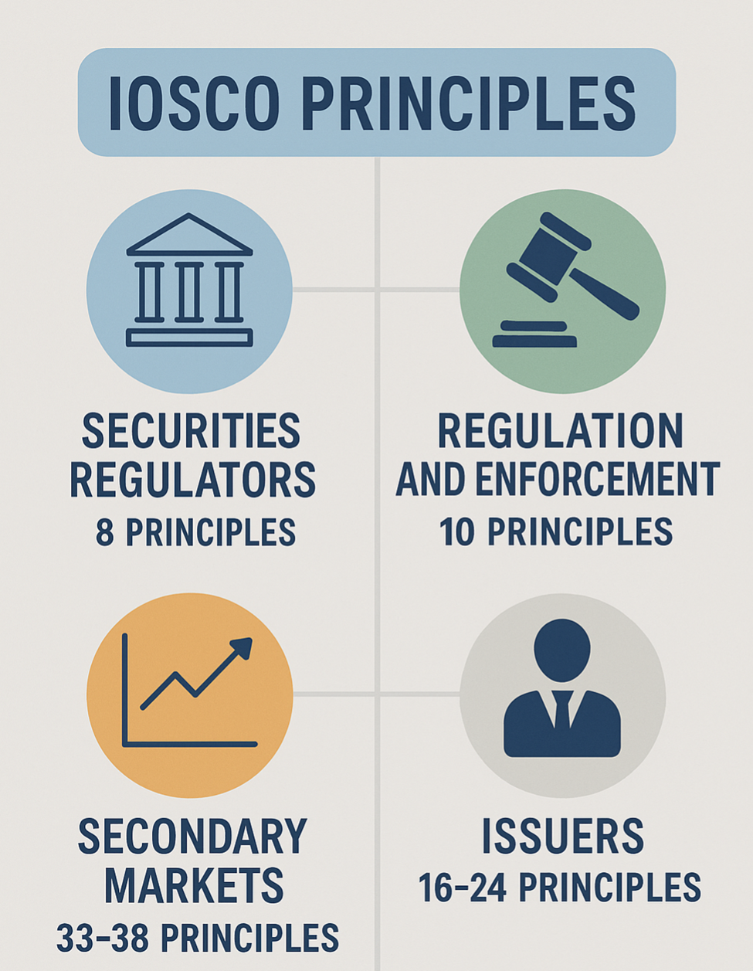
Qatar Financial Centre Regulatory Authority

Slide 9
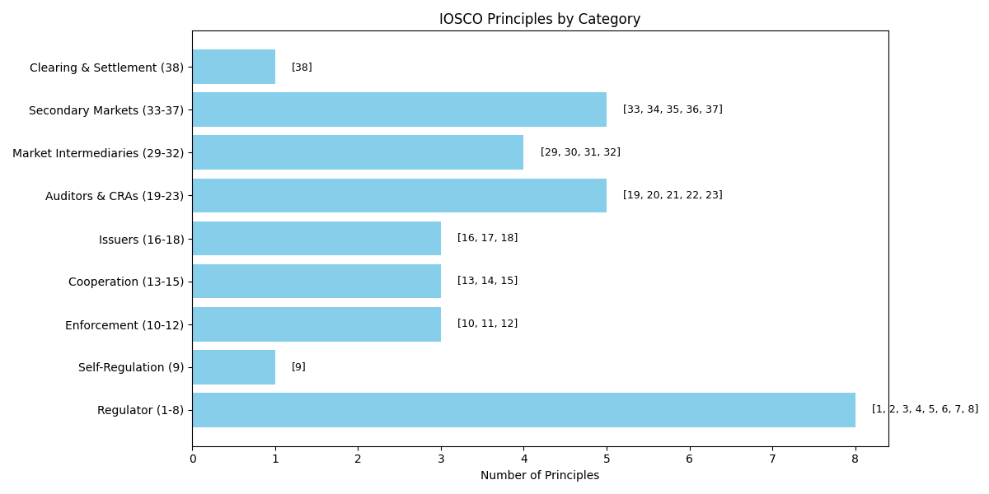


Slide 10
Supervision Types:
Prudential Supervision
Prudential Supervision: refers to the regulatory oversight and monitoring of firms with the goal of ensuring their (financial) safety, soundness, and stability. The primary focus is to protect the interests of depositors, and other stakeholders in the financial system by preventing (excessive) risk-taking by the firms. Key aspects:
Risk Management: Assessment and monitoring of the risk profile of financial institutions, including evaluation of credit risk, market risk, liquidity risk, operational risk, and other types of risks.
Capital Adequacy: Ensuring adequate capital levels are maintained to absorb potential losses and ensure that institutions can continue to operate even in adverse economic conditions.
Liquidity Management: Assessment of a firm's ability to meet its short-term obligations and coverage for withdrawals and other demands for funds.
Corporate Governance: Assessment of the effectiveness of boards of directors, management practices, and internal controls to prevent fraud and mismanagement.
Others: Stress testing, consumer protection, resolution planning.
Qatar Financial Centre Regulatory Authority

Slide 11
Supervision Types:
Conduct Supervision
Conduct Supervision: refers to the regulatory and supervisory approach that focuses on ensuring the fair treatment of customers, ethical behaviour, and the integrity of financial institutions. The primary goal of conduct supervision is to protect the interests of consumers and maintain the trust and stability of the financial system. It goes beyond traditional prudential supervision (which focuses on financials to address issues related to the behaviour and culture within firms). Key aspects:
Consumer Protection: Safeguarding the interests of consumers, including ensuring that financial products/services are legal, transparent, and suitable for customers.
Ethical Behaviour: Promotion of ethical conduct within financial institutions, emphasizing honesty, integrity, and responsible business practices.
Market Integrity: Prevention of market abuses, such as insider trading, market manipulation, and fraudulent activities.
Culture and Governance: Assessment of the effectiveness of boards of directors, management practices, and incentive systems to ensure they do not incentivize unethical or risky behaviour.
Remediation and Enforcement: Broad powers to take corrective actions such as imposing fines, disgorgement, or criminal referral.
Others such as: Compliance and reporting, Whistleblower Protection, Training and Awareness.
Qatar Financial Centre Regulatory Authority

Slide 12
Rules-based Supervision
Refers to the regulatory and supervisory approach that relies on clearly defined and predetermined rules, regulations, and standards to oversee and govern the behaviour and operations of firms and market participants.
Key considerations:
Prescriptive Regulations: Detailed and specific regulations with little room for interpretation.
Enforcement: Typically results in predefined penalties and enforcement actions for specific (in)/(mis) actions.
Discretion: Regulators/supervisors have limited discretion in applying rules-based supervision.
Regulatory Reporting: Often require extensive regulatory reporting by firms.
Complexity: The multitude of rules can create compliance challenges for firms.
Flexibility: May lack flexibility in responding to changing market conditions.
Legalistic Approach: Primarily based on the letter of the law rather than the spirit or intent of the law.
Regulatory Burden: Compliance, administrative, and financial burden can be substantial.
Qatar Financial Centre Regulatory Authority

Slide 13
Principles-based Supervision
Refers to the supervisory approach that relies on high-level principles, values, and overarching standards to guide the behaviour and operations of firms and market participants. This approach is less prescriptive and allows for greater flexibility in compliance and decision-making. Key considerations:
High-Level Principles: High-level principles are often articulated in a regulatory framework or code of conduct.
Flexibility: Allows firms to exercise judgment and flexibility in how they achieve compliance and are not bound by rigid, prescriptive rules.
Adaptability: Deemed more adaptable to changing market conditions, emerging risks, and evolving business models.
Focus on Outcomes: Emphasizes the achievement of desired outcomes rather than compliance with rules.
Ethical and Cultural Considerations: emphasis on fostering an ethical corporate culture within firms.
Cultural Transformation: Promotion of a culture of responsibility, integrity, and ethical behavior within the financial industry.
NOTE: the principles base supervision poses challenges in terms of enforcement and interpretation, as it may require regulators to exercise more judgment and discretion in their oversight activities. Striking the right balance between principles-based and rules-based supervision is a common challenge for regulatory authorities seeking to ensure both flexibility and compliance in the financial industry.
Qatar Financial Centre Regulatory Authority

Slide 14
Regulatory Approach
Prudential (Banking, Insurance, Pension) Supervision
Financial Stability Objective: efficiency and safety of institutions.
Financial Soundness Objective: institutional level – avoiding or preventing – failure.
Favors: confidentiality.
Relevance: payment systems.
Major Risk: Systemic Risk
Key Tool: capital requirements.
Emerging regulatory challenges: FinTech, digitization, cyber resilience.
Securities Market Supervision
FS Objective: transparency and efficiency of markets.
Financial Soundness Objective: managing disruption and failures of entities (except exchanges).
Favors: transparency.
Relevance (Inv. Prot.): transparency, disclosure, suitability.
Major Risks: (mis) Conduct, Reputational, and Contagion Risks
Key Tools: conduct and enforcement action.
Emerging regulatory challenges: Enhanced prudential oversight, ESG reporting, Tokenization, Hybrid market participants.
Qatar Financial Centre Regulatory Authority

Slide 15
Regulatory Challenges
Systemic challenges:
Conflicts of interest: affects reputation and market integrity.
Weaknesses in market function: affects economic growth and development.
Economic Conditions: affects regional and global positioning and resiliency.
Regulatory/Legal/Judicial capacity: affects enforcement and market integrity.
Greed: affects competitiveness and proper functioning of markets.
Non-systemic challenges: (can easily be fixed)
*Fit and Proper
*Incompetence/poor business model
*Failure or bad behavior by market participants
*Greed
*Lack of Supervisory and Regulatory Resources

Slide 16
Regulatory Challenges and the Financial Stability overlap
Regulatory distance/arbitrage; avoidance of conflicting regulatory approaches is a relevant. Regulatory arbitrage is a reputation and financial stability destroyer
Keeping abreast of (international) developments and constantly changing market and regulatory landscape. Market dynamics and alignment with global markets is key.
(Lack of) proper ancillary services (eco-system) and Investors’ sophistication.
Need for close coordination between:
  regulators.
  regulators and the government.
  regulators, the government and the public.
Qatar Financial Centre Regulatory Authority

Slide 17
Securities Supervision:
General Remarks and Considerations
Main risks (macro) of the securities market: Reputational and Contagion Risk (high interconnectedness with systemic sectors).
Risk Mitigation: to meet supervisory mandate of market integrity and consumer protection. The constant drive to prevent abusive practices and enhance disclosure practices.
The securities sector is a risk-bearing sector. The Regulator’s role is to create a transparent marketplace and not a riskless one.
Market integrity is the driver of the Securities Supervisory approach. Enhanced focus on suitability of market participants.
Enhanced attention on strengthening prudential oversight of the Securities Sector

Slide 18
Key Areas of Focus in Prudential Supervision
Of Securities Firms
Systemically Important Market Infrastructures and Participants
Clearing Agencies
Depositories
Clearing Broker-Dealers
Custodians
Critical Supervisory Considerations
Capital Adequacy
Segregation and Safekeeping of Customer Funds and Assets
Management of Key Risks: e.g., counterparty, credit, interest rate, market and liquidity
Key Systems and Controls: e.g., margin/collateral management; pricing and VAR models
IT Infrastructure: e.g., security, reliability, redundancy
Stress-testing
Always taking into account the nature, size and complexity of the entity and its business

Slide 19
Key Takeaways
Rigorous Risk Management: Underscore the importance of rigorous risk management practices and oversight, particularly for entities involved in high-leverage and complex financial activities.
Effective Monitoring and Enforcement: The need for effective regulatory monitoring and enforcement mechanisms is critical to prevent and detect fraudulent activities and systemic risks issues.
Transparency and Accountability: Increased transparency and accountability measures are essential to ensure that market participants and service providers operate within regulatory frameworks and adhere to ethical standards.
Systemic Risk Awareness: Awareness and assessment of systemic risk are vital to prevent financial instability resulting from the failure of significant market participants.
Regulatory Skepticism: Market and product skills for assessment and risk identification purposes are required for proper and effective supervisory exertion.
Investor Protection and Innovation: Protection of investor and market integrity are not exclusively market conduct matters. Exerting proper prudential supervision is of utmost importance.
Qatar Financial Centre Regulatory Authority

Slide 20
Securities Regulatory Roadmap
Upscaling Supervisory Capacity and Capabilities: further develop supervisory approach and reach (risk-based, conduct, and intrusive).
Upgrading and enhancing national and international visibility, recognition, and reputation of our securities market infrastructure including its supervision: Engagement and participation (regional and global).
Engaging peer Regulators (local and global) for technical and also relational objectives. Risk and Oversight Committees ?
(Actively) engaging market participants for enhanced ancillary services for a healthy and efficient eco-system.
Platforms, Exchanges, policies and Supervisory Framework should be up to current international standards.
Achieve Regulatory nimbleness to be adaptable to constant changes and growth.
Qatar Financial Centre Regulatory Authority

Slide 21

Re-thinking our Supervisory approach
Structural or cosmetic change(s) required?
Solving or Managing problems
Behavioral, Cultural or institutional change(s) required?
Transparency is usually the most helpful tool
Forward or Backward focused?
Forward-looking and future proof remedies should be pursued, if possible.
Enforcement aimed at punishing poor behavior is both forward and backward looking (“restoration” principle)

Slide 22
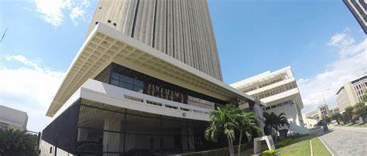
Concluding thoughts
We need to achieve Regulatory Agility as a realistic and attainable objective.
Beware of Regulatory Anxiety !

Slide 23

Let’s interact on Securities Supervision
Slido QR code for people to login and start voting.
Joining in - https://app.sli.do/event/b1tHEr7FZLSWFnPKK3qyFa
Slido Code: 3422628
Qatar Financial Centre Regulatory Authority

