Slide 1

The role of qualitative measures in effective supervisory frameworks
2 October 2025

Slide 2

Overview
Background
Initiatives to strengthen supervisory effectiveness
Key elements of supervisory cycle
Qualitative measures
Risk Assessment BMA and Governance
Supervisory Judgement

Slide 3
Background
Market turmoil in March 2023 led to the failure of several US regional banks (Silicon Valley, First Republic, Silvergate) and forced merger of a Swiss G-SIB (Credit Suisse)
Turmoil exposed shortcomings in banks’ risk management, viability of business models and supervisory oversight
Lessons re-learned:
- Banks and financial firms can meet all quantitative requirements and still face crisis of confidence
- Importance of prompt supervisory actions
- Qualitative measures are fundamental in addressing problems in banks and financial firms at an early stage

Slide 4
Initiatives to strengthen supervisory effectiveness
Risk scoping
Risk assessment, Supervisory actions and qualitative measures
Supervisory communication
Monitoring and escalation
**Supervisory judgment underpins every stage of the supervisory process

Slide 5

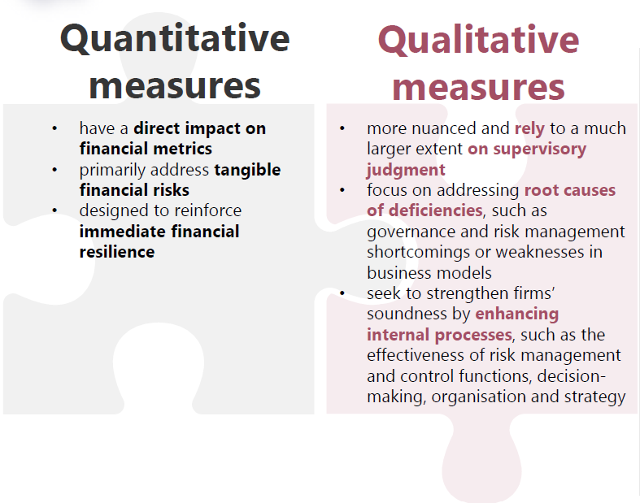

Slide 6
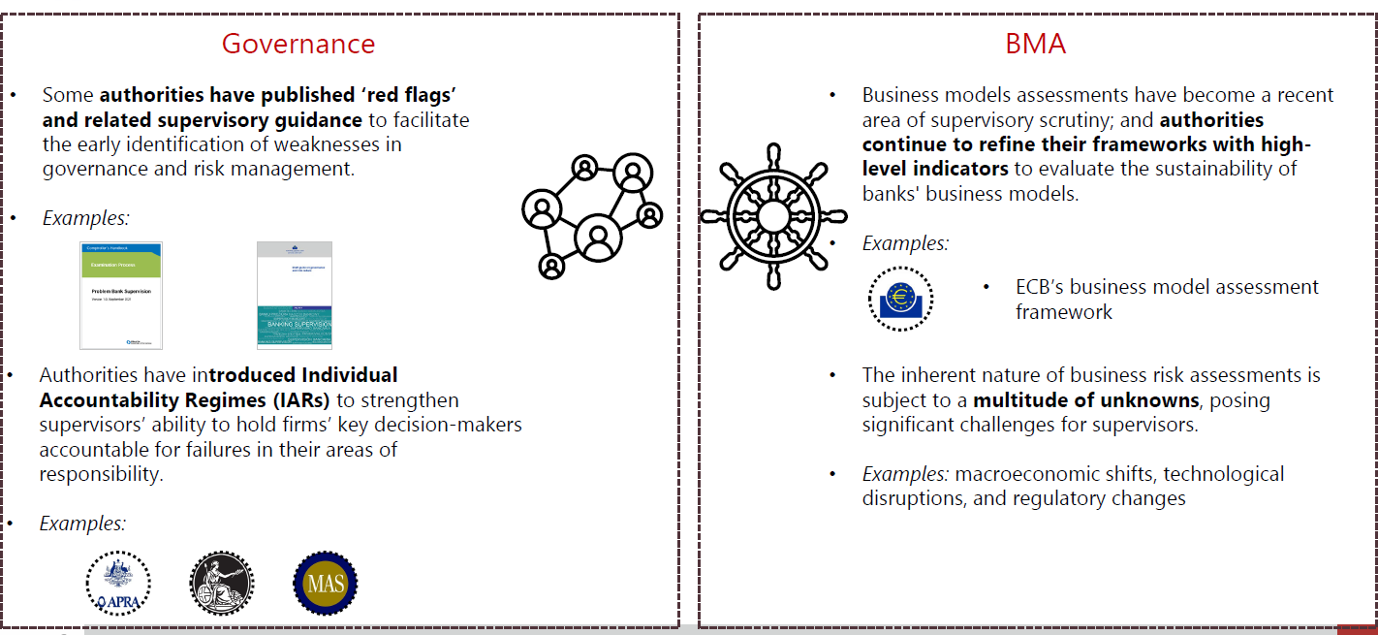
Risk Assessment of Governance and BMA’s

Slide 7
Policy Recommendation: Supervisory Judgement
* (Continue to) foster sound professional judgement of front-line supervisors.
* Strike appropriate balance between rules versus discretion in supervisory frameworks.

Slide 8
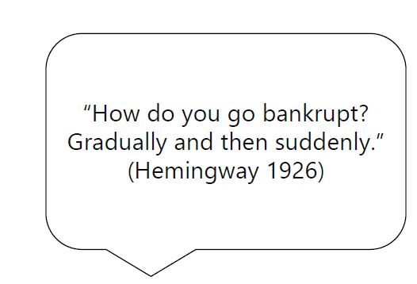
Final takeaway
Structured, well-targeted communication is the foundation for effective supervision

Slide 9

Thank you

