Slide 2

Overview:
Retail Repos
Stock Lending
Margin Trading
Presented to:
Bank of Jamaica
3 October 2025
Notes:
---
This presentation provides a comprehensive guide to effectively conducting supervisory examinations of member brokers in Jamaica, ensuring compliance with regulatory standards and promoting financial integrity.
Image source: Microsoft 365 content library

Slide 3
Retain Repurchase (Repo) Transactions
In Jamaica, Retail Repurchase (Repo) transactions are used by JSE Member Dealers (securities firms) to obtain short-term, collateralized liquidity facilities (loans) from investors
. This allows the Member dealers to acquire short-term funding while providing the investors with a relatively secure, low-risk investment.
How the transaction works
  Member Dealers typically purchase and hold large positions in GOJ- and BOJ-issued securities (typically, high-quality long-tenor bonds)
  A client provides the Member Dealer with cash.
  In exchange, the dealer gives the client eligible securities, with a legally binding agreement to repurchase them at a higher price at a later date.
  The securities act as collateral, and the difference between the initial sale price and the repurchase price serves as the interest earned by the investor.

Slide 4
Retain Repurchase (Repo) Transactions
Common uses and features
For investors: Retail repos are generally seen as a safe, short-term investment option for clients who have surplus cash, as the transaction is secured by the underlying collateral.
For dealers: Dealers use the cash from these transactions for short-term funding needs.
Currencies: Under the regulatory framework, retail repo transactions can be conducted in Jamaican or US dollars.
Collateral: A range of securities can be used as collateral, including Government of Jamaica (GOJ) securities, foreign government securities, and Bank of Jamaica (BOJ) Certificates of Deposit.

Slide 5
Financial Market Infrastructure (FMI) Entities and Account Structures
Jamaica Stock Exchange
Member Firm 1
Member Firm 2
Member Firm 3
Member Firm 1
Customer A
  Cash trading
  Margin
  Stock Lending
  Retail Repo
Customer B
  Cash Trading
JAMCLEAR at JCSD
(for Transactions in GOJ and BOJ instruments)
Member Firm 1 (own account)
Member Firm 1 f/b/o Customers A, B and C (omnibus)*
Jamaica Central Securities Depository
Member Firm 1 (own account)
Member Firm 1 f/b/o/ Customer A (individual)
Member Firm 1 f/b/o/ Customer B (individual)
Member Firm 1 f/b/o Customers A and B (omnibus).
JCSD Trustee Services Limited
(for Retail Repurchase Transactions)
Member Firm 1 (own account)
Member Firm 1 f/b/o Customers A, B and C (omnibus)*
* Verify
Notes:
---
Planning involves setting examination scope, timelines, and assembling the appropriate team with the skills required to address identified risks effectively.
Image source: Microsoft 365 content library

Slide 6
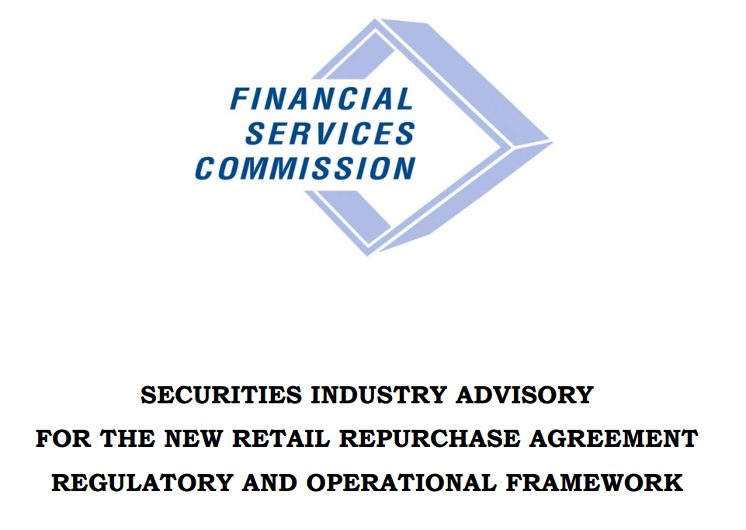
Retain Repurchase (Repo) Transactions
1507106176_securities-industry-advisory-new-retail-repo-regulatory-and-operational-framework-july-2015-final.pdf`

Slide 7
Retain Repurchase (Repo) Transactions
A “liquidity squeeze” – a tightening of liquidity – can occur where a Member Dealer uses the proceeds of (short-tenor) retail repos to invest in other long-term securities, creating potential liquidity risks if the market experiences shocks.
This can create systemic risk where the same practices are widespread across the industry.

Slide 8
Retain Repurchase (Repo) Transactions
How Retail Repos Create Liquidity Squeeze Risk
Duration Mismatch:
Securities dealers take in short-term funds from retail clients through repurchase agreements (repos) and invest these funds in longer-term assets, primarily Government of Jamaica (GOJ) and Bank of Jamaica (BOJ) securities.
Liquidity Risk:
If clients need their funds back unexpectedly, or if the market conditions change, dealers may not be able to quickly sell their long-term securities to meet these demands, leading to a liquidity shortage.
Systemic Risk:
A large-scale liquidity squeeze in the retail repo market can create systemic risk for the entire Jamaican financial system, as it could impact the ability of banks and other institutions to meet their obligations.

Slide 9
Retain Repurchase (Repo) Transactions
Regulatory and Central Bank Response
Retail Repo Mismatch Ratio (RRMR):
The FSC monitors and manages the risk arising from these duration and liquidity mismatches by issuing guidelines for the RRMR.
Emergency Liquidity Facility:
The Bank of Jamaica can activate its Emergency Liquidity Facility or other facilities to provide Jamaica Dollar liquidity to financial institutions experiencing shortages.
Central Bank Operations:
In times of tightening liquidity, the BoJ can also use instruments like the 14-day repo auction and reintroduce facilities for longer-term liquidity provision to support the market.
Purchasing GOJ Securities:
The BoJ can purchase Government of Jamaica securities on the secondary market to inject liquidity into the financial system.

Slide 10
Stock Lending
Stock lending is a process where investors holding particular securities (lenders) allow others (borrowers) to temporarily borrow their owned securities in exchange for a fee and/or interest.
This enables the lender to earn passive income on their existing shares while the borrower uses them for activities like short selling, and requires the borrower to provide collateral.

Slide 11
Margin Trading
Margin trading on the Jamaica Stock Exchange involves an investor borrowing funds from their broker to buy securities (versus using their own cash), using their existing investments and/or cash as collateral.
This leverage amplifies potential returns but also increases risk, as investors pay interest on the borrowed funds and must maintain a minimum equity balance (the maintenance margin) to avoid forced selling of their securities.

Slide 12
Margin Trading
Risks of Margin Trading
Amplified Losses:
Just as gains are amplified, losses can also be magnified if the market moves against the investor's position.
Interest Costs:
Investors must pay interest on the borrowed funds, which reduces overall profits.
Margin Calls:
Failure to meet maintenance margin requirements can lead to margin calls, forcing the investor to add more funds or sell securities, potentially at a loss.
Liquidation:
The brokerage firm can sell the investor's securities to satisfy the margin loan if the account falls below the required equity level.

Slide 13
Let’s Discuss!

