Slide 1

Practical Guidance for Conducting Prudential Reviews of JSE Member Dealers
Presented to:
Bank of Jamaica
2 October 2025
Notes:
AI-generated content may be incorrect. --- This presentation provides a comprehensive guide to effectively conducting supervisory examinations of member brokers in Jamaica, ensuring compliance with regulatory standards and promoting financial integrity. Image source: Microsoft 365 content library

Slide 2
Practical Guidance for Conducting Prudential Reviews of JSE Member Dealers
Disclaimers:
This presentation is intended to highlight key general principles and concepts, which derive primarily from my experience as Senior Counsel with the US SEC’s national compliance examination program.
The purpose is not to instruct you as to the particulars of the Jamaican regulations and rules, or even the BOJ’s practices.
I have incorporated references to Jamaican regulations and rules and market institutions for illustrative purposes; however, I am not an expert in those particulars and so any such references may not be 100% accurate.
Finaly, I am a lawyer, not an accountant, and so we will not be doing any math today!
Presented to:
Bank of Jamaica
2 October 2025
Notes:
AI-generated content may be incorrect. --- This presentation provides a comprehensive guide to effectively conducting supervisory examinations of member brokers in Jamaica, ensuring compliance with regulatory standards and promoting financial integrity. Image source: Microsoft 365 content library

Slide 3

Key Themes and Concepts for Today
Tailor each review to the particulars of the firm
Look beyond the numbers
Employ the right mix of people and resources
Approach engagements with a healthy dose of skepticism
Notes:
--- Supervisory authorities are responsible for licensing, monitoring, and enforcing compliance among brokers, conducting examinations, and taking corrective actions to uphold regulatory standards. Image source: Microsoft 365 content library

Slide 4
The Three Pillars of Prudential Regulation of Securities firms
Capital Adequacy Ratio
Tier 1 capital (high-quality, highly liquid and permanent capital base to support the firm’s operations and meet its obligations to clients) vs, risk-based assets and risk exposures
Net Free Capital
The amount of unencumbered capital readily available to absorb losses and meet obligations; a more direct measure of liquid, available capital for daily operations
Segregation and Safekeeping of Customer Assets
- Individual accounts established at JCSD f/b/o each customer
- Omnibus accounts established at JCSD f/b/o customers
- In the case of reverse repos, also account(s) set up with JCSD Trustee Services Limited ()
Notes:
--- Examiners prioritize brokers based on risk factors such as financial condition, past compliance history, and market activity, ensuring that resources target areas of greatest regulatory concern. Image source: Microsoft 365 content library

Slide 5
Financial Market Infrastructure (FMI) Entities and Account Structures
Jamaica Stock Exchange
Member Firm 1
Member Firm 2
Member Firm 3
Member Firm 1
Customer A
Cash trading
Margin
Stock Lending
Retail Repo
Customer B
Cash Trading
JAMCLEAR at JCSD
(for Transactions in GOJ and BOJ instruments)
Member Firm 1 (own account)
Member Firm 1 f/b/o Customers A, B and C (omnibus)*
Jamaica Central Securities Depository
Member Firm 1 (own account)
Member Firm 1 f/b/o/ Customer A (individual)
Member Firm 1 f/b/o/ Customer B (individual)
Member Firm 1 f/b/o Customers A and B (omnibus).
JCSD Trustee Services Limited
(for Retail Repurchase Transactions)
Member Firm 1 (own account)
Member Firm 1 f/b/o Customers A, B and C (omnibus)*
* Verify
Notes:
--- Planning involves setting examination scope, timelines, and assembling the appropriate team with the skills required to address identified risks effectively. Image source: Microsoft 365 content library

Slide 6
Conduct Tailored Reviews
What is the size and type of firm?
For example:
- Size by capital, number of customers, value of trades, volume of trades;
- Type by proprietary trading versus customer trading, carrying of customer accounts versus execution only, bank-affiliated or stand-alone
What types of accounts and transactions does the firm offer?
For example: equities, fixed income, retail repos, margin trading, stock lending, correspondent accounts for foreign brokers, direct market access, trading on foreign exchanges?
What customer types and account structures does the firm have?
For example:
- Customer type: institutional, retail, funds
- Account structure: individual, nominee, omnibus, correspondent
Notes:
--- Planning involves setting examination scope, timelines, and assembling the appropriate team with the skills required to address identified risks effectively. Image source: Microsoft 365 content library

Slide 7
Conduct Tailored Reviews (cont’d)
Whether the firm is part of a bank or other financial holding group, or a stand-alone financial institution
- Are the firm’s PPSCs integrated with a larger group framework?
- Is the firm financially backstopped by a parent FI?
How long has the firm been in operation, and what is its history of compliance?
Notes:
--- Planning involves setting examination scope, timelines, and assembling the appropriate team with the skills required to address identified risks effectively. Image source: Microsoft 365 content library

Slide 8

Look Beyond the Numbers “Accounting is not bean counting!”
Compliance and Risk Management Policies and Procedures
- Are they tailored to the firm’s business?
- Do they cover all relevant areas?
- Have they been effectively implemented?
- Testing and monitoring
Systems and Controls
- Same considerations as P&Ps
- Order entry, clearing and settlement, pricing, value-at-risk, margining, collateral management, concentration risk, etc.
- Exception reports
- Are the systems integrated / do they communicate with each other?
Key Functions and People
- Trading
- Operations and back office
- Risk management
- Compliance
Are they sufficiently competent? Do they effectively communicate with each other?
Notes:
--- Examiners prioritize brokers based on risk factors such as financial condition, past compliance history, and market activity, ensuring that resources target areas of greatest regulatory concern. Image source: Microsoft 365 content library

Slide 9
Look Beyond the Numbers (cont’d)
Prescribed Account Structures
- Do they comply with applicable Regulations and Rules?
- Especially important for customer accounts, in order to ensure segregation from firm assets in the event of the firm’s insolvency
Prescribed Legal Agreement and Instruments
- Are all the relevant required agreements and instruments in place?
- Account Agreement
- Delegations / POAs
- Margin trading, Stock Lending, Retail Repo, etc.?
- Are they (1) current and (2) compliant?
Notes:
--- Examiners prioritize brokers based on risk factors such as financial condition, past compliance history, and market activity, ensuring that resources target areas of greatest regulatory concern. Image source: Microsoft 365 content library

Slide 10
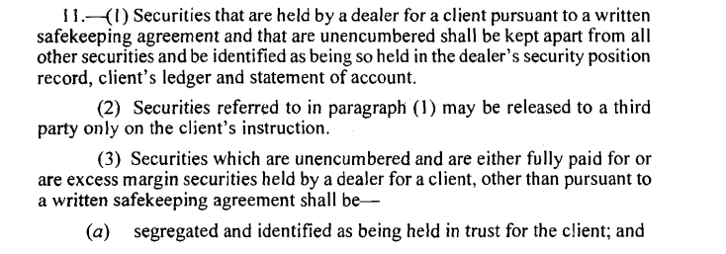
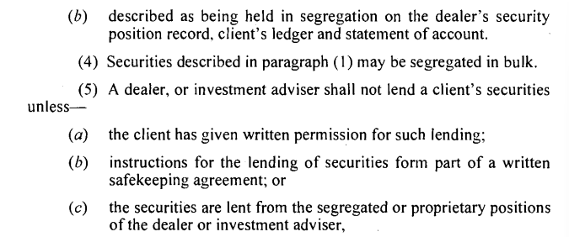
Look Beyond the Numbers (cont’d)
Notes:
--- Examiners prioritize brokers based on risk factors such as financial condition, past compliance history, and market activity, ensuring that resources target areas of greatest regulatory concern. Image source: Microsoft 365 content library

Slide 11
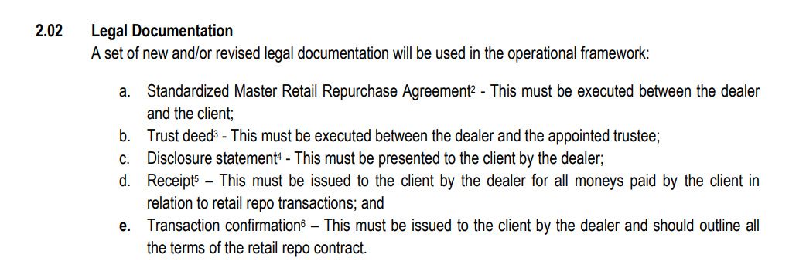
Look Beyond the Numbers (cont’d) Example: Reverse Repos
Notes:
--- Examiners prioritize brokers based on risk factors such as financial condition, past compliance history, and market activity, ensuring that resources target areas of greatest regulatory concern. Image source: Microsoft 365 content library

Slide 12
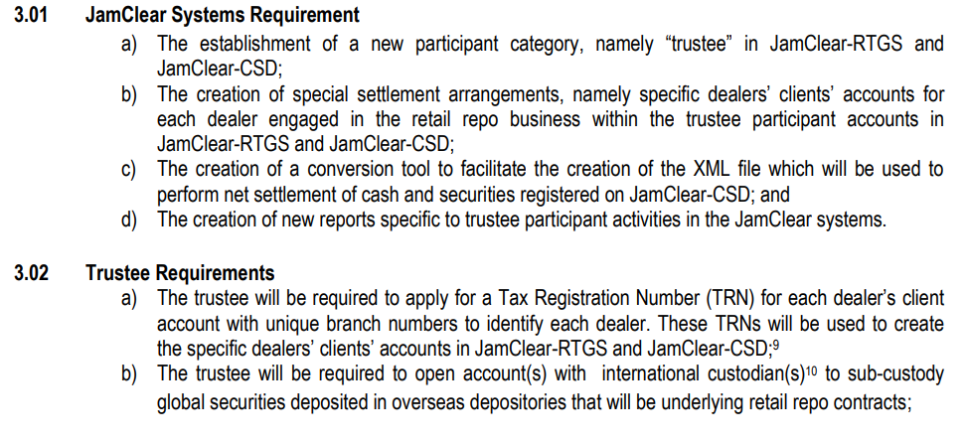
Look Beyond the Numbers (cont’d) Example: Reverse Repos
Notes:
--- Examiners prioritize brokers based on risk factors such as financial condition, past compliance history, and market activity, ensuring that resources target areas of greatest regulatory concern. Image source: Microsoft 365 content library

Slide 13
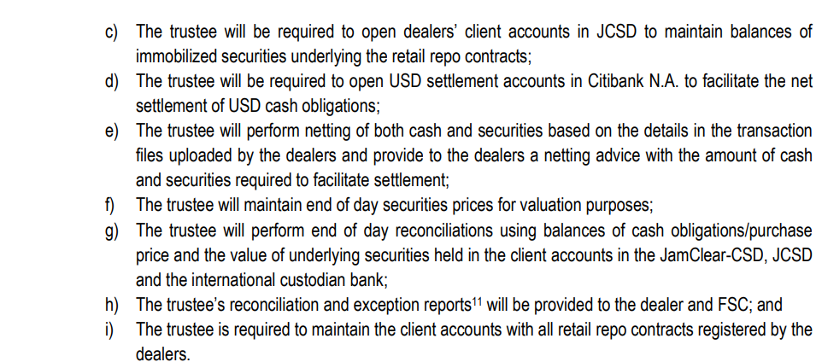
Look Beyond the Numbers (cont’d) Example: Reverse Repos
Notes:
--- Examiners prioritize brokers based on risk factors such as financial condition, past compliance history, and market activity, ensuring that resources target areas of greatest regulatory concern. Image source: Microsoft 365 content library

Slide 14
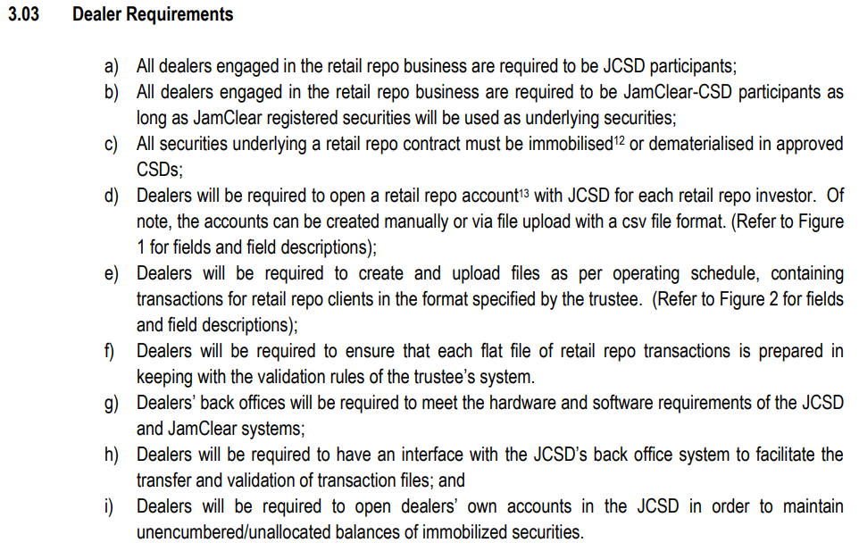
Look Beyond the Numbers (cont’d) Example: Reverse Repos
Notes:
--- Examiners prioritize brokers based on risk factors such as financial condition, past compliance history, and market activity, ensuring that resources target areas of greatest regulatory concern. Image source: Microsoft 365 content library

Slide 15
Look Beyond the Numbers (cont’d) Example: Submissions to the Jamaica Stock Exchange
Notes:
--- Examiners prioritize brokers based on risk factors such as financial condition, past compliance history, and market activity, ensuring that resources target areas of greatest regulatory concern. Image source: Microsoft 365 content library

Slide 16
The Right Mix of People and Resources
Accounting
Stock-and-trade accounting specialists to review financial statements, capital adequacy ratio and net free capital calculations, etc.
Legal-minded (not necessarily lawyers!)
Specialists who can interpret regulations and rules and evaluate the relevant legal instruments and agreements and account structures
Market Operations / Risk Management
Specialists who understand the trading environment and can evaluate the operational trading and risk management infrastructure
Notes:
--- Examiners prioritize brokers based on risk factors such as financial condition, past compliance history, and market activity, ensuring that resources target areas of greatest regulatory concern. Image source: Microsoft 365 content library

Slide 17
The Right Mix of People and Resources (cont’d)
Techies
Specialists who can evaluate the trading and settlement platforms and code-based risk management applications (VAR models, margining systems, etc.) and the protocols by which they communicate
“People” People
Specialists who can facilitate good relationships with firm personnel, conduct effective interviews, etc.
Project Managers
Specialists who are good at planning reviews and keeping them organized and on track
Notes:
--- Examiners prioritize brokers based on risk factors such as financial condition, past compliance history, and market activity, ensuring that resources target areas of greatest regulatory concern. Image source: Microsoft 365 content library

Slide 18
Be Skeptical and thorough
Securities firms by nature operate on a risk-versus-reward ethos.
This can include regulatory risk, where they view potential penalties for non-compliance as a cost of doing business
In times of crisis – for example, a market correction or liquidity crunch – cracks appear and firms might be tempted to take shortcuts … hence the need for strong risk management programs with strong oversight
Notes:
--- Examiners prioritize brokers based on risk factors such as financial condition, past compliance history, and market activity, ensuring that resources target areas of greatest regulatory concern. Image source: Microsoft 365 content library

Slide 19
Be Skeptical and thorough (con’t) “If your not taking some flak, you’re not flying over the target!”
“Trust but Verify”
- Evaluate key verbal and written representations and records made by the firm against primary sources
- “If its not written down, it didn’t happen!”
- Follow up on any discrepancies!
Triangulate Data Across Various Sources
- Compare various statements, records, reports, applications, etc. with each other to see if the “tick and tie”
- Communication with relevant FSC and JSE is critical
- Again, follow up on any discrepancies!
Don’t be afraid to ask questions, press for answers and stress-test responses
- “Please explain that to me.”
- “What exactly do YOU mean when you say that?”
- “Walk me through how you do [function XYZ].”
Notes:
--- Examiners prioritize brokers based on risk factors such as financial condition, past compliance history, and market activity, ensuring that resources target areas of greatest regulatory concern. Image source: Microsoft 365 content library

Slide 20
Be Skeptical and thorough (con’t)
Drill Down
- Make further, more granular requests for documents and information when warranted
Be Curious
- Ask good questions
- Look “around corners” and “under rocks”
Be Prepared
- Know the relevant regulations and rules
- Conduct appropriate pre-review diligence
Notes:
--- Examiners prioritize brokers based on risk factors such as financial condition, past compliance history, and market activity, ensuring that resources target areas of greatest regulatory concern. Image source: Microsoft 365 content library

Slide 21

Questions???
Notes:
--- Broker supervision in Jamaica is guided by laws such as the Securities Act and relevant FSC guidelines. These regulations establish standards for broker conduct, reporting, and compliance requirements essential for market stability. Image source: Microsoft 365 content library

Slide 22
Thank You!
Notes:
AI-generated content may be incorrect. --- This presentation provides a comprehensive guide to effectively conducting supervisory examinations of member brokers in Jamaica, ensuring compliance with regulatory standards and promoting financial integrity. Image source: Microsoft 365 content library

